Slide 1


CYBERATTACK DETECTION
Logistic Regression with the usage of Neural Networks and Deep Learning
- Team Groot

Slide 2

INTRODUCTION
The current rise in hacking and computer network attacks throughout the world has heightened the demand for improved intrusion detection and prevention solutions. Cyberattacks and cybersecurity risks have skyrocketed with new technologies such as cloud computing, fog computing, edge computing, and the Internet of Things (IoT).
These assaults are capable of infiltrating computer network-related environments, cloud-based services, and social networks, causing financial and reputational damage. Network intrusion detection systems play a significant role in every computer network defense system as they are used to detect and prevent malevolent activities.
Netflow analysis needs efficient deep learning methods to perform real-time traffic analysis, aided by analysis of historical network traffic using traditional machine learning methods, hybrid architectures, and novel computing paradigms, such as federated learning and granular computing. With the increasing volume of network traffic in high-speed networks, research on intelligent network traffic analysis is vital for network management and security.

Slide 3
Deep learning specifically has been studied to solve many typical netflow analysis tasks, which have proven to be a potential general framework for analyzing network traffic. Intrusion detection systems are critical in identifying abnormalities and assaults on the network, which have grown in size, stealth, and pervasiveness. Artificial neural networks have been used in anomaly detection to determine if data behavior is normal or aberrant.
With reasonable performance, this network can identify both known and unknown threats. Deep neural networks are capable of self-learning and detection of previously unknown types of network attacks, in contrast to existing systems based on signature analysis. Another advantage of neural networks is their ability to detect unknown attacks (zero-day attacks), functioning in a noisy environment, preserving operability with incomplete or distorted data, forecasting user behavior, and the emergence of new attacks.
This Special Issue aims to provide a state-of-the-art overview of novel emerging deep learning architectures and models for network intrusion and malware detection. Original research articles with a focus on both practical as well as on theoretical topics and problems, as well as review articles, are welcome.

Slide 4
Potential topics include but are not limited to the following
Artificial intelligence methods for discovering vulnerabilities and malware in wireless sensor networks and Internet of Things devices
Artificial intelligence
methods for preventing
new cyberattacks
Convolutional neural network architectures for netflow analysis and anomaly detection
Deep learning-based solutions for low
resource Internet of Things devices
Deep learning methods to track malicious behavior and hybrid attacks in social networks
Hybrid models, ensemble learning, and federated learning for cybersecurity

Slide 5
Potential topics include but are not limited to the following
Netflow analysis for edge, fog, and mist computing devices
Network intrusion and malware detection using deep learning
Novel ideas, algorithms, models, frameworks, and systems for cyber-attack prediction and mitigation
One-shot and few-shot learning for cyberattack recognition
Zero-day attack recognition using deep learning methods
Real-time botnet and malware detection

Slide 6

Objective
The ultimate goal of cyberattack detection is to protect the information from being stolen or compromised. To achieve this we look at 3 fundamental goals of cybersecurity.
1. Protecting the Confidentiality of data.
2. Preserving the Integrity of data.
3. Restricting the Availability of data only to authorized users.

Slide 7
Methodology
Semi-supervised learning
Encrypted message
Logistic regression MODEL
Logistic regression will be used to solve this problem. We will analyze the packets flowing to determine if the requests are safe or unsafe.
Semi-supervised learning will be used to identify the malicious packets in the network and block the connection.
Malicious packets have encrypted message or code embedded in their packets which will be used as data to teach the model

Slide 8
Problems faced with the model
As the model works with the application of unsupervised learning for anomaly detection it is intrinsically more difficult than supervised learning as it does not have corresponding output.
Due to the difficulty, the algorithm might be less accurate as input data is not labeled, and algorithms do not know the exact output in advance.
Against supervised models we have used gradient descent-based method to generate adversarial samples. Therefore, an slower update learning can occur since an update is performed only after we go through all the observations.

Slide 9

01
03
02
04
Drawbacks with the project
Due to its lack of prior knowledge it becomes difficult & provide less accurate result.
At the same time, it is also a time-consuming process. The learning phase of the algorithm might take a lot of time, as it analyses and calculates all possibilities
Therefore, we have to carefully train the model so that we do not decrease the model’s accuracy.
As the model exceptionally implements Unsupervised learning it brings upon its own drawbacks. For example one of the key problems with using this learning model to train is that the model learns from raw data without any prior knowledge.

Slide 10

MOTIVATION
Our motivation for cyberattack detection is to provide a security means for detecting cyber attacks like
phishing , social media fraud , DoS , DDoS and Virus etc.
As all this things can lead to dangerous situations for people whose accounts got hacked or
money got stolen from their bank accounts etc.
Our project can help in detecting this breaches in security and help in patching of these
breaches and also prepare for the cyber attacks .

Slide 11
Comparisons of models
Our project uses a model name iforest model which in based on python 3.This model can be imported in python compiler.This model is used in Machine Learning based projects.Isolation forest is a machine learning algorithm for anomaly detection.It's an unsupervised learning algorithm that identifies anomaly by isolating outliers in the data.
Isolation Forest is based on the unsupervised algorithm. It isolates the outliers by randomly selecting a feature from the given set of features and then randomly selecting a split value between the max and min values of that feature. This random partitioning of features will produce shorter paths in trees for the anomalous data points, thus distinguishing them from the rest of the data.Isolation Forest instead works by isolating anomalies explicitly isolating anomalous points in the dataset.
The Isolation Forest algorithm is based on the principle that anomalies are observations that are few and different, which should make them easier to identify. Isolation Forest uses an ensemble of Isolation Trees for the given data points to isolate anomalies.

Slide 12
Comparisons of models
Isolation Forest recursively generates partitions on the dataset by randomly selecting a feature and then randomly selecting a split value for the feature. Presumably the anomalies need fewer random partitions to be isolated compared to "normal" points in the dataset, so the anomalies will be the points which have a smaller path length in the tree, path length being the number of edges traversed from the root node.
Using Isolation forest we can not only detect anomalies faster but we also require less memory compared to other models.The two parameters are used in this project are:
<1>n_estimators:The number of base estimators in the ensembles in the ensemble(default=100).
<2>contamination:the proportion of outliers assumed in the training set.
There is another model which is also used for this from a another project that is:
K-Means Clustering is an Unsupervised Learning algorithm, which groups the unlabeled dataset into different clusters. Here K defines the number of predefined clusters that need to be created in the process, as if K=2, there will be two clusters, and for K=3, there will be three clusters, and so on.
It computes the centroids and iterates until we it finds optimal centroid. It assumes that the number of clusters are already known. It is also called flat clustering algorithm. The number of clusters identified from data by algorithm is represented by ‘K’ in K-means.

Slide 13
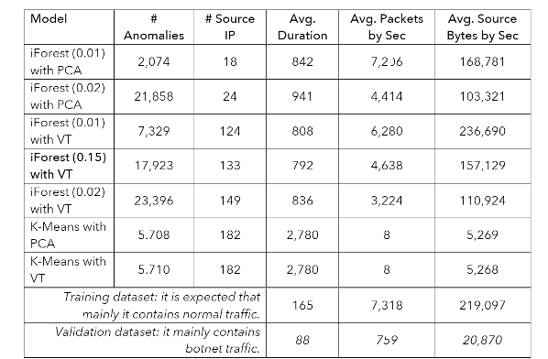
Comparisons of models
In this model the data points are assigned to a cluster in such a manner that the sum of the squared distance between the data points and centroid would be minimum. It is to be understood that less variation within the clusters will lead to more similar data points within same cluster.
But we used isolation forest model since this model gave us desirable output where as the k-means clustering not gave the output according to project.Additional we also adopted a variance threshold for this so that we can eliminate low variance which are assumed not useful for prediction and PCA technique for analyzing large datasets containing a high number of dimensions/features per observation, increasing the interpretability of data while preserving the maximum amount of information, and enabling the visualization of multidimensional data.for both isolation forest and K-means clustering . Below is the data set from the both models.

Slide 14

Other approaches to solving this problem
Another approach to solve this problem is using random forest algorithm to solve this issue.
Random forest is a Supervised Machine Learning Algorithm that is used widely in Classification and Regression problems. It builds decision trees on different samples and takes their majority vote for classification and average in case of regression.
One of the most important features of the Random Forest Algorithm is that it can handle the data set containing continuous variables as in the case of regression and categorical variables as in the case of classification. It performs better results for classification problems.
Isolation Forest is similar in principle to Random Forest and is built on the basis of decision trees. Isolation Forest, however, identifies anomalies or outliers rather than profiling normal data points.

Slide 15
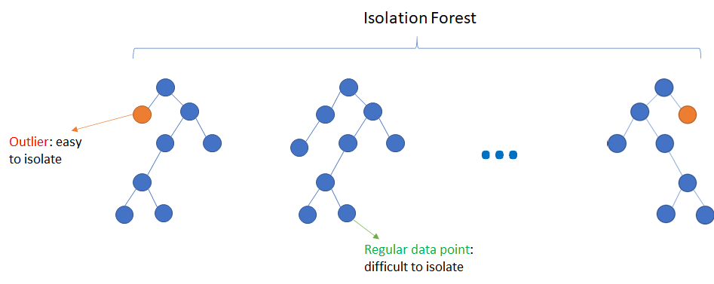
Other approaches to solving this problem
So the question which arises in everyone’s head is which’s a better algorithm? Random forest using supervised learning or isolation forest using unsupervised learning?
The experiments show that Random Forest can detect more than 9% of botnets for 8 out of 13 scenarios. Moreover, the accuracy on the 5 most difficult scenarios can be increased thanks to a bootstrap method.
Coming to Isolation Forest, it can detect more than 95% of botnets for 10 out of 13 scenarios.
Hence it’s clearly seen that using the Isolation forest is a better approach thanks to the ability to identify the anomalies or outliers rather than profiling normal data points.
It is concluded that Isolation Forest algorithm has characteristics of low time complexity and quantitative description of anomalies, which is obviously superior to other algorithms.
However, it has disadvantage in detecting local anomaly point, which affects the accuracy of algorithm.

Slide 16
Implementation Steps
In this project we have explored two ML projects consisting of cyberattacks. The first task is to analyse different combinations of features anomaly detection. For the second task an sample is generated for evading the detection of a Supervised machine learning model.
Our primary focus is the 2nd task, i.e., evading anomaly detection. Therefore we have used two Ml techniques used for anomaly detection:
iForest Clustering
K-Means Clustering.

Slide 17
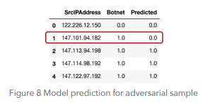
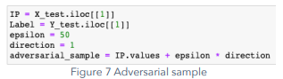
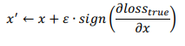
Implementation Steps
The implementation of this method is relatively straightforward . For these tasks it was generated an adversarial sample for just one Source IP. From Figure 6 it will be chosen the row 1, where the Source IP Address 147.101.94.182 is correctly predicted as Botnet. The Figure 7 shows the code which generates an adversarial sample for this row. A couple of notes regarding this implementation:
• epsilon was defined with a large value because the data is not normalized: it is considered unnormalized is more practical for “backpropagate” the epsilon to the NetFlow traffic.
• The sign of direction was directly set as 1: It was not possible to determine the gradient function given a Skit Learn model (there is not direct access to the function weights). Figure 7 Adversarial sample Finally, in Figure 8 it is presented the prediction of the model for this new adversarial sample. As we can verify, now the model does not predict the Source IP as Botnet. The accuracy of the model decreases to 0.89.

Slide 18
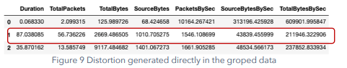
Traffic perturbation
The main challenge was to introduce the epsilon generated in section 8.1 (epsilon = 50) in the NetFlow traffic given under a group operation. The first attempt consisted in just use this epsilon in all the traffic related to the target IP Source. This idea did not work because the model has generated features as TotalBytes by seconds that are created from the division of another two features. The introduction of the epsilon in all the traffic distorted these types of metrics. The second attempt considered introducing the effect of this epsilon accumulated in just one traffic row.
This attempt is registered in the file A2_preprocessing-perturb-traffic. Even when it was generated a perturbation very similar to the target, again, the generated features are “defending” the model against this attack. The Figure 9 and Figure 10 show how similar is the distortion generated.

Slide 19
Anomaly Detection Techniques
iForest:
For this model, it was utilised the default parameters for the method Isolation Forest in Skit Learn.
Two of the most relevant parameters are:
• n_estimators: The number of base estimators in the ensemble (default = 100). • contamination: The proportion of outliers assumed in the training set.
iForest:
For this model, it was utilised the default parameters for the method Isolation Forest in Skit Learn.
Two of the most relevant parameters are:
• n_estimators: The number of base estimators in the ensemble (default = 100). • contamination: The proportion of outliers assumed in the training set.

Slide 20
Conclusion
The method worked best was iForest under Variance Threshold.But not in principle component analysis even with its high dimension reduction, is generating less confident results.The reason for this is that the reduction operation it is not suitable for an anomaly detection task because they tend to absorb the specific anomaly variability. Regarding k-means, the performance tends to be very rigid,means it have same results under PCA and VA. This lack of flexibility difficult to tune the model to address the task.
Respect to iForest model, this method worked better in this context because allow some grade of flexibility to search the anomalies in the data. Even though,the results seem not to be perfectly accurate, as the set of anomalies detected has different metrics compared to validation set. It is considered that this issue is more related with the feature generation task rather than the models performance itself.

Slide 21
Research Paper on Cyber Security
A comprehensive review study of cyber-attacks and cyber security; Emerging trends and recent developments
Mrs. Ashwini Sheth Research Paper on Cyber Security
International Journal of Information Management Data Insights
Artificial Neural Network for Cybersecurity: A Comprehensive Review

Slide 22
REFERENCES
https://www.nist.gov/media/0
https://www.dhs.gov/
http://164.100.47.193/Refinput/New_Reference_Notes/English/Cyber-Security-FINAL.pdf
https://www.researchgate.net/publication/260126665_A_Study_Of_Cyber_Security_

Slide 23


THANKS!

